Slide 1
DSC 530 Winter Term 2021 Final Project
Lucas Edmisten
March 7th, 2021

Slide 2
Overview of Data and Project
I want to look deep into NFL players to find out what makes a player the most valuable. It is tough to decide what makes a player better than another player. There are the general stats you see and then a lot of it is based off the viewers perception.
Each player has a given score that ranks them on their production called there “Fantasy Value”. My goal is to find out if there is data that will correlate closely with a player’s “Fantasy Value”. A correlation in data could lead to being able to predict which players may provide more value in the years to come. I will look at information like Age, Height, Forty Yard Dash, IQ Test, how many games they won in college, etc...

Slide 3

Primary Goal
My Main Research Questions will be –
Is there any relations to specific variables that show a player to have a higher likelihood of having increased “Fantasy Value”?

Slide 4
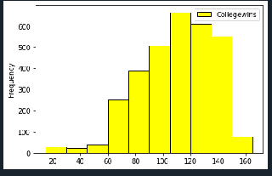
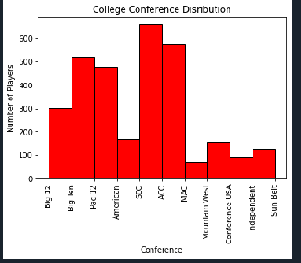
5 Variables and their Histogram
From this data we see a couple different things. Most players come from one of 4 colleges. The main one being the SEC.
The number of College wins per players seems to be normal with some right alignment.
Number of Wins in College
College Wins

Slide 5
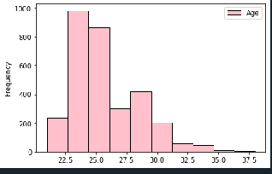
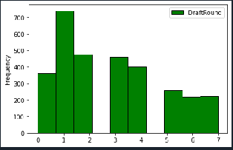
5 Variables and their Histogram
Both of these Histograms point to players longevity in the NFL. Which could end up helping you determines one's productivity or “Fantasy Value. Clearly most players age with the most players is around 24 so that is likely most peoples prime of their career. And then the earlier you get drafted the longer you will be in the league for the most part.
Age Distribution of Players
Players Draft Round
Age
Draft Round

Slide 6

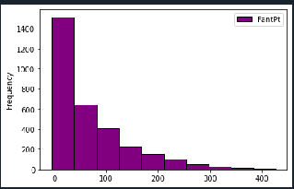
5 Variables and their Histogram
Distribution of Fantasy Value
Here is the distribution of players Fantasy Points or “Fantasy Value”. The majority of players are on the lower end of value. You can see from the data it is very hard to pick one on the right side of that distribution.
Fantasy Points

Slide 7
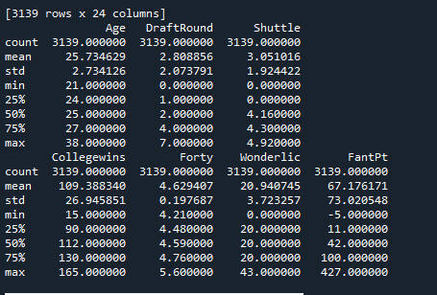
Summary of these variables and a few more

Slide 8
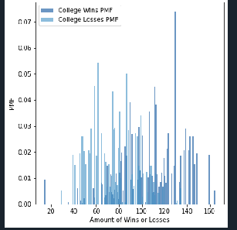
Probability Mass Function
Wins and Losses for NFL players when they were in College
Here is the Probability Mass Function of the number of games a player will win and lose in College. For players that play in the NFL their PMF for Wins is higher than their PMF for losing in college.

Slide 9


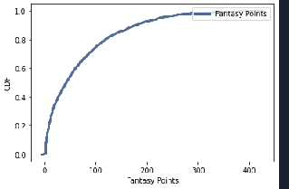

Cumulative Distribution Function
Percentile rank for each fantasy points value
Here we see an exponential function that is telling us what percentile each value of fantasy points is in. If a player scores 50 points he is right around the 50% percentile rank. Whereas 200 points puts you around 80% percentile rank and 10 points puts you about at 20%.
CDF
Fantasy Points

Slide 10
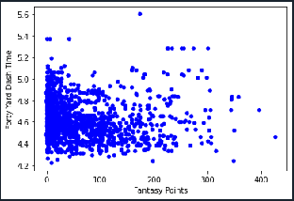
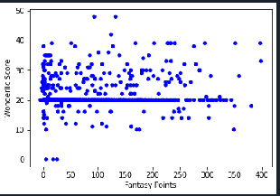
Two Scatterplots
These scatter plots show 40-yard dash time vs fantasy value and the Wonderlic (IQ) score vs Fantasy Value
The 40-yard dash is where I was hoping to see a trend, but I don’t not think we can really make much from it.
The Wonderlic doesn’t really show a much correlation with fantasy value either. There is a small positive linear trend but not enough to do much. It does appear that almost all players fit between a 10 and 40 on the Wonderlic score.
Forty Yard Dash vs Fantasy Points
Wonderlic vs Fantasy Points
Forty Yard Dash
Wonderlic Score
Fantasy Points
Fantasy Points

Slide 11
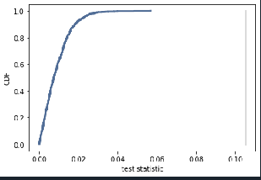
Hypothesis Testing – There is correlation in Age and Fantasy Value.
Distribution of the Test Statistic – Fantasy Values vs Age
Here based on our p-values for the hypothesis and null hypothesis we can accept this data a
0.0 = Permutation test to compute the p-value of an observed difference in means, we can assume that there is no difference between the groups and generate simulated results by shuffling the data.
1.0 = p-value for the null hypothesis and its significance.

